Slide 1
One for All and All for One Simultaneous Approximation of Multiple Functions over Distributed Streams
https://www.flickr.com/photos/pasukaru76/5597863793
Arnon Lazerson, Moshe Gabel, Assaf Schuster - Technion I.I.T. , Daniel Keren - Haifa University
This research was supported by the European Union's Horizon 2020 Research And Innovation Programme under grant agreements no. 688380 and 727277-2.
Notes:
Hi,
I am Arnon Lazerson. I’m a PhD student at the IIT, and today I’m going to talk about “Simultaneous Approximation of Multiple Functions over Distributed Streams”
The work presented here was done in collaboration with Mickey and Assaf from the Technion and Danny from the University of Haifa.

Slide 2
Distributed Stream Processing
Stream mining
But, streams are Often distributed
Distributed algorithms (graph algs./model fitting/learning…)
But, data is not static
Centralizing and re-running is very expensive
We must be smarter!
Notes:
What distributed stream processing is all about. It’s a combination of two traditional research areas:
Stream mining, continuous queries, space/runtime efficiency
Distributed algorithms/queries. One shot queries. Communication efficient
LOCAL conditions guarantee GLOBAL solution did not change by much.

Slide 3
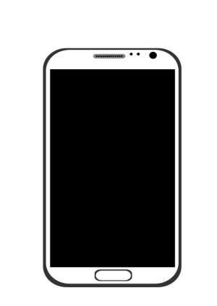
Distributed Stream Processing
Space efficient
Time efficient
Communication efficient
Battery lifetime
Network congestion
Computation bottleneck at central server
Smartphones
WSN

Slide 4
Distributed Stream Processing
Multiple sources/nodes/sensors…
Nodes see different data streams
Data is dynamic
Can’t store or centralize
Nodes communicate over network
Goal: efficiently compute $f$
$$f\left( \right)$$
Notes:
Nodes = servers/sensors/cell phones …
Data = scalar / vector / matrix / time series ….
network: all-to-all network, wireless network, p2p… ← not all links exist
Compute: a function over all data / monitor a query
Reduce: # of messages, size of messages,

Slide 5
Distributed Model
Output $f\left(\frac{\sum{v_{i}}}{k}\right)$
Coordinator
$$G$$
Nodes
$$v_{1}$$
$$v_{2}$$
$$v_{3}$$
$$v_{k}$$
Streams
$$S_{1}$$
$$S_{2}$$
$$S_{3}$$
$$S_{k}$$
Notes:
We work with a slightly less general model
Nodes communicate only with the coordinator
We look at a function over the avaerage
First I’ll describe the Distributed Model we work with.
We have k physically distributed nodes and a designated coordinator node - G. The nodes can only communicate with the coordinator, but not with each other.
Each node a holds a local statistics vector $v_{i}$ that is continuously updated by a distributed stream $S_{i}$
For example stream may contain information about webpage requests, and the statistics vector is simply a histogram of requests per webpage.
We are interested in the value of a function (like max or norm) over the average of the local values at the nodes.
The average vector is called the global statistics vector
The coordinator $G$ keeps track of a global condition $f\left(global_vector\right)≤T$, and must issue an alert when this condition is breached (that is when f(global_vector)>T).
This is a rather general model, which describes many practically important problems. It can be enriched by augmenting the local vectors $v_{i}$ with functions of their raw coordinates.
Clearly the most naïve approach of communicating all the data to the coordinator is highly inefficet

Slide 6
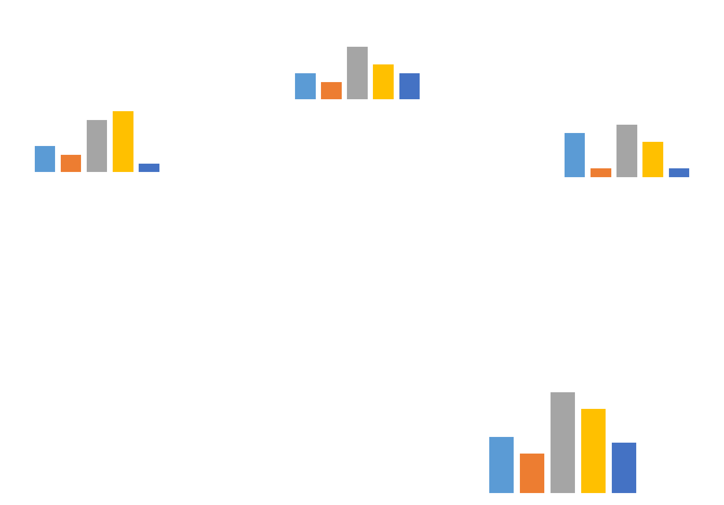
Function Over the Average
Distributed Histogram
Distributed Graph
Notes:
These are two example for a function over the average , scatter matrices is another

Slide 7
Single Function Approximation
Approximate a function over distributed streams
Tradeoff accuracy for efficiency
Early work contains special-purpose algorithms
Sampling, sketching, local constraints
Geometric monitoring
General approach - can track any function of the average of streams
Notes:
Sampling - no good for bursts
Sketching – summary allowing to calculate f within some (statistical error bounds)
Local constraints – constraints on the nodes guaranteeing the required error bounds.
each tailored to the type of function of interest
Monitor domain of the function rather than image

Slide 8
Geometric Monitoring
Admissible region: $A=\left\{v | f\left(v\right)≤T\right\}$
Safe zone $C$ is a convex subset of $A$.
Convexity: $v_{1},v_{2}…v_{k}∈C ⇒v=\left(\frac{\sum{v_{i}}}{k}\right)∈C⊆A.$
Node $i$ is silent as long as $v_{i}∈C$.
$$A=\{v|f(v)≤T\}$$
$$C$$
$$v_{2}$$
$$v_{1}$$
$v$=$\left(\frac{\sum{v_{i}}}{k}\right)$
$$v_{3}$$
Notes:
Monitor the domain and not the image
As long as all vi’s are in c v is guaranteed to be c
Each node can check a local condition
So we need to find a way to define local condition that guarantees correctness
Geometric Monitoring offers different approach to define local conditions at the nodes.
Unlike the naïve approach here it is guaranteed that while the local condition hold the global condition also holds
First some definitions
The set $A=\left\{v | f\left(v\right)≤T\right\}$is called the admissible region.
A_bar is the complement of A $\overline{A}=\{v|f\left(v\right)>T\}$
Assume we have some convex subset of $A$ called $C$.
$C′$s convexity guarantees that if $v_{1},v_{2}…v_{k}∈C$,
then $v=\left(\frac{\sum{v_{i}}}{k}\right)∈C⊆A.$
Node $i$ can stay silent as long as $v_{i}∈C$. Each node needs only to locally check if $v_{i}∈C$
Rembebr that the value of vi changes over time as the streams arrive

Slide 9
Tracking a Single Function
Poll nodes and compute${ v}_{0}$($v$ at t=0)
Output $f\text{(}v_{0}\text{)}$
As long as $f$($v_{0}$)$− ε≤f\left(v\right)≤f\text{(}v_{0}\text{)}+ε$
Do nothing
Restart algorithm
Two threshold crossing problems

Slide 10
Tracking Multiple Functions
Centralize and compute
Inefficient even for a single function
No per-function overhead
Independently track each function
Each function is tracked efficiently
But, each function adds to the communication cost
Can we do better?

Slide 11
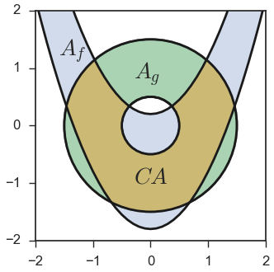
Multiple Functions with GM
Multiple functions require multiple admissible regions.
Use $CA$the common admissible region
Intersection of individual admissible regions.
$v∈CA$ ⇒ all approximations hold
$$f\left(x,y\right)=y −x^{2}−0.8, { ε}_{f }=1$$
g$\left(x,y\right)=x^{2}+y^{2}−1, { ε}_{g }=0.5$

Slide 12
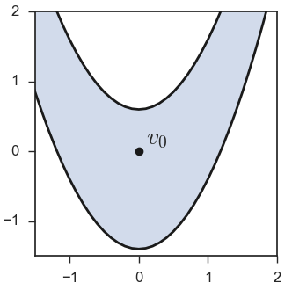
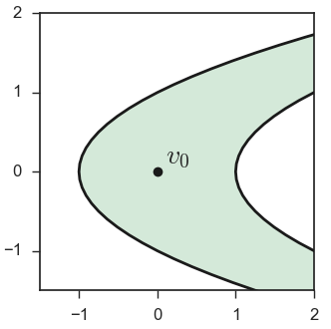
Common Admissible Region
$$f\left(x,y\right)=x^{2}−y −0.4, { ε}_{f }=1$$
$$g\left(x,y\right)=y^{2}−x, { ε}_{g }=1$$
Notes:
Here we have the Admissible regions for two function with their respective error bounds

Slide 13
Common Admissible Region
Notes:
Lets see how the common admissible looks
Recall that we need to find a safe-zone in the common admissible region
There is a direct method but it is costly (runtime)

Slide 14
Safe Zones

Slide 15
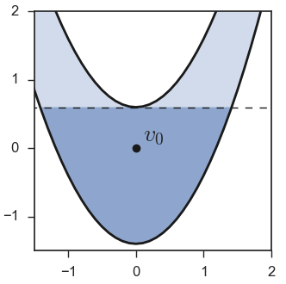
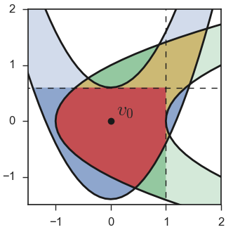
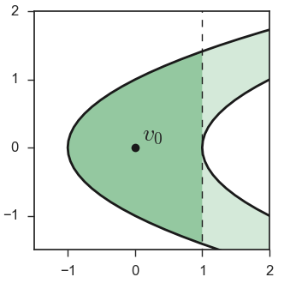
Common Safe Zone - CSZ
Notes:
We suggest intersecting the individual safe-zones

Slide 16
Evaluation Methodology
Applied Common safe zone & independent tracking
Counted messages
Cost is reported as ratio to naive
Expect CSZ to be better than indep

Slide 17
Tracking PCA Scores
KDDCUP-1999 dataset
TCP connection data
37 features (duration, protocol, bytes sent, …)
Nodes maintain $m×m$ scatter matrices ($m$=37)
Track top $l$ PCA scores: $t_{k}=\frac{\sum_{i=1}^{k}{λ_{i}}}{\sum_{i=1}^{m}{λ_{i}}}$ , for $k=1…l$
Notes:
Sliding window 1000
The top $\ell$ PCA-Score's $t_1 \dots t_{\ell}$ can be used to construct a scree-plot~\cite{cangelosi2007component}, or find how many dimensions must be retained to guarantee a specific percentage of the variance.
urthermore, using $t_{i} - t_{i-1}$ the contribution of a specific eigenvalue $\lambda_i$ can be approximated. This has applications in graph theory when $A$ is a adjacency matrix or graph Laplacian~\cite{spielman2007spectral, brouwer2011spectra}.

Slide 18
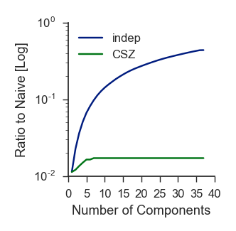
Comm. Cost for PCA Scores
$$ε=0.2$$
$$ε=0.01$$
Notes:
Additive error

Slide 19
Tracking Regression and Condition Number
Intel Lab dataset
16 sensors measuring humidity, temperature light and voltage
Track (Generalized) Least Squares Model
Humidity as a function of temperature light and voltage
Track Condition number
Metric for the stability of the linear system = $\frac{λ_{1}}{λ_{,m}}$
Notes:
linear regression fits a linear model to a set of observations, and is commonly used for prediction and analysis tasks.
Some linear systems are very sensitive to measurement errors, meaning solutions may be inaccurate. The condition number is a common metric to assess the stability of a linear system. Therefore, we are interested in tracking both a least squares regression model and its condition number.

Slide 20
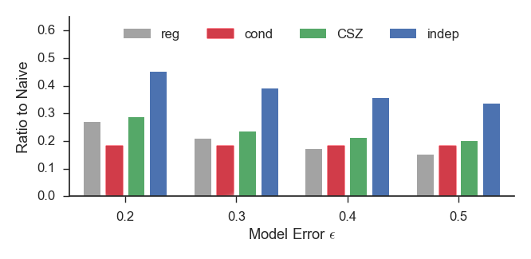
Regression and Condition Number Communication Costs
Notes:
The condition number was allowed a relative error of 0.2 in all cases.
Figure shows the relative communication cost of tracking the regression model and condition number for different values of model approximation error $\epsilon$. The condition number was allowed a relative error of $0.2$ in all cases.

Slide 21
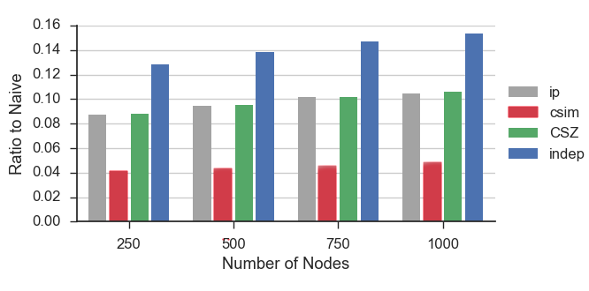
Scalability
$$ε_{ip }=0.1$$
$$ε_{csim }=0.1$$
$ε_{ip }=0.$05
$$ε_{csim }=0.1$$
Notes:
The CSZ method is scalable, in the sense that its advantage over the independent method does not depend in any way on the number of nodes $k$.
The increase in communication cost of the CSZ method is the result of the increased cost of the worst individual function.
We demonstrate this by tracking $f_csim and f_ip using the TWIT dataset with up to 1000 simulated nodes.

Slide 22
One for All and All for One
One for all
One SZ for all functions
All for one
Tracking all function for (nearly) the price of one
Notes:
To conclude, I presented a communication efficient method to track the value of multiple function over distributed streams
Using GM framework and the common safe-zone
Evaluation shows that we can track multiple functions with nearly the cost of the worst one.

Slide 23
Thank you! Questions
?

Slide 24
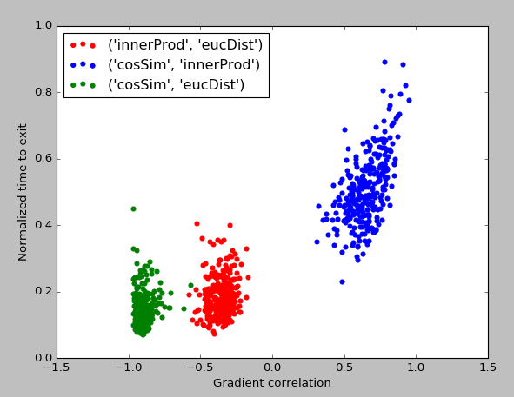
Function Correlations

